Slide 1
Session Three Exploring Resources
Liturgy with Older people 21st November 2017
James Woodward

Slide 2
Celebrating Age in Worship - Suggestions
Using the Bible
Poetry and Prose Readings
Hymns
Prayers
Addresses about Ageing

Slide 3
A single Focussed liturgy to celebrate Age?
‘All are Called’ – the Lord of all Age
Is there a time of the year when we gather to affirm, pray with, and celebrate the gifts of age?
Carers, Centres of Care, Voluntary Agencies
Listening to the experiences of Older People
Encouraging intergenerational friendships

Slide 4
I made hay while the sun shone. My work sold. Now, if the harvest is over And the world cold, Give me the bonus of laughter
John Betjeman The Last Laugh

Slide 5
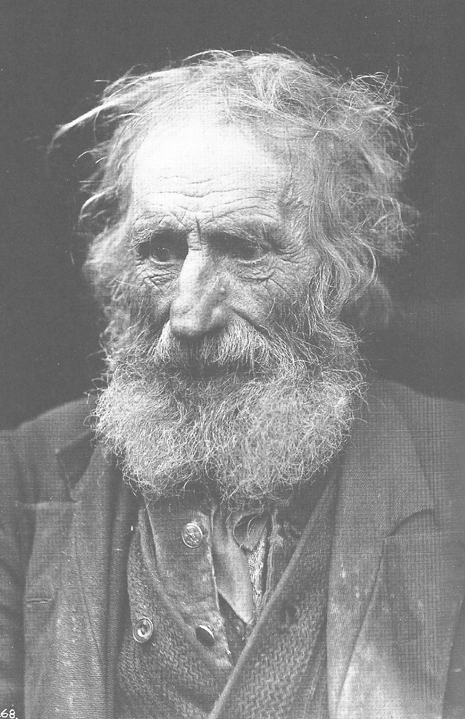

Slide 6
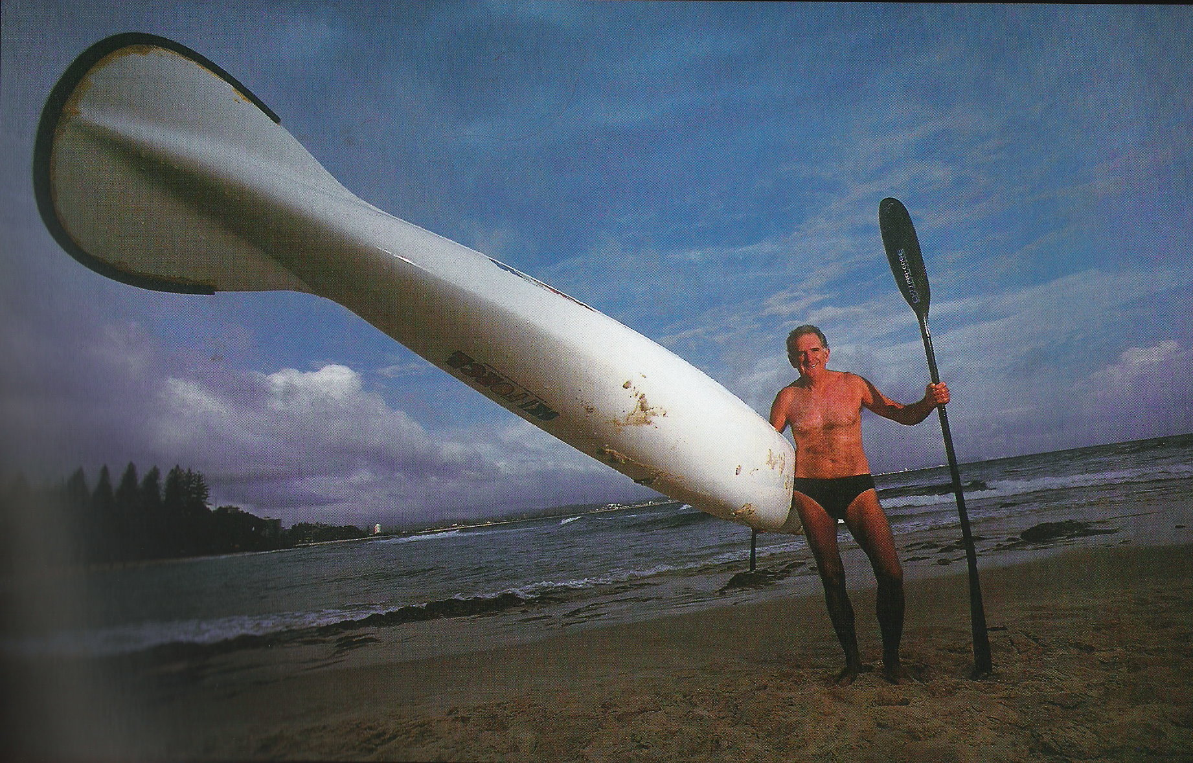
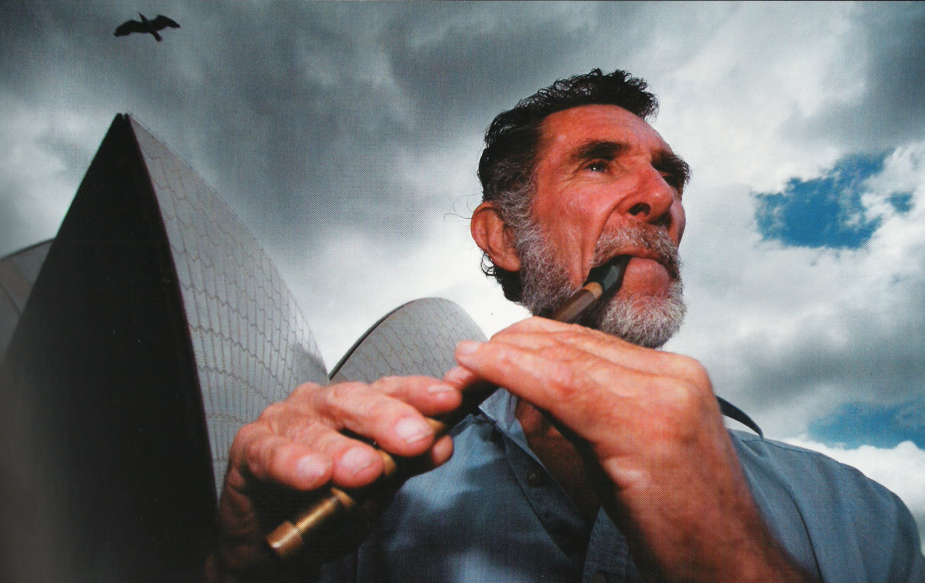

Slide 8
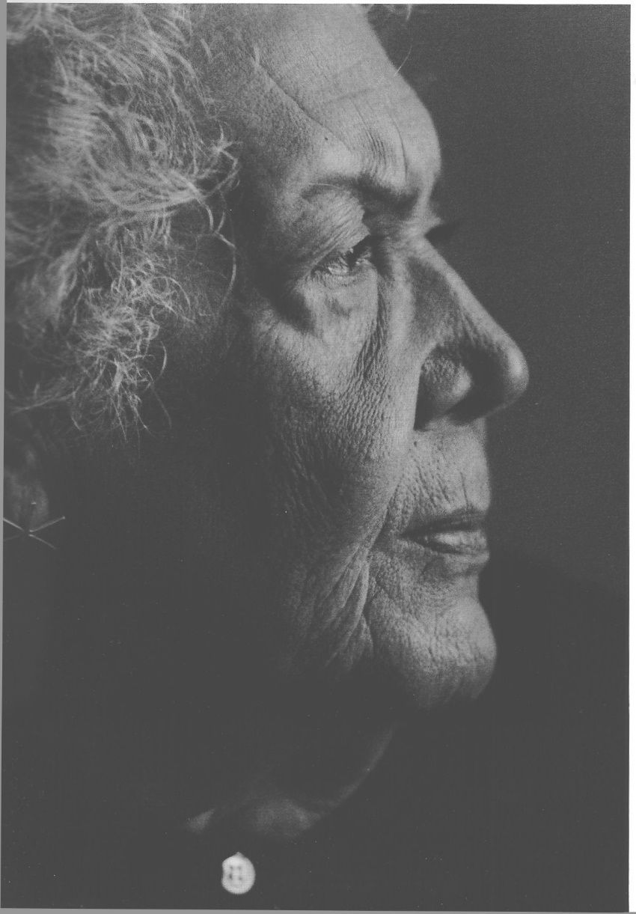

Slide 9
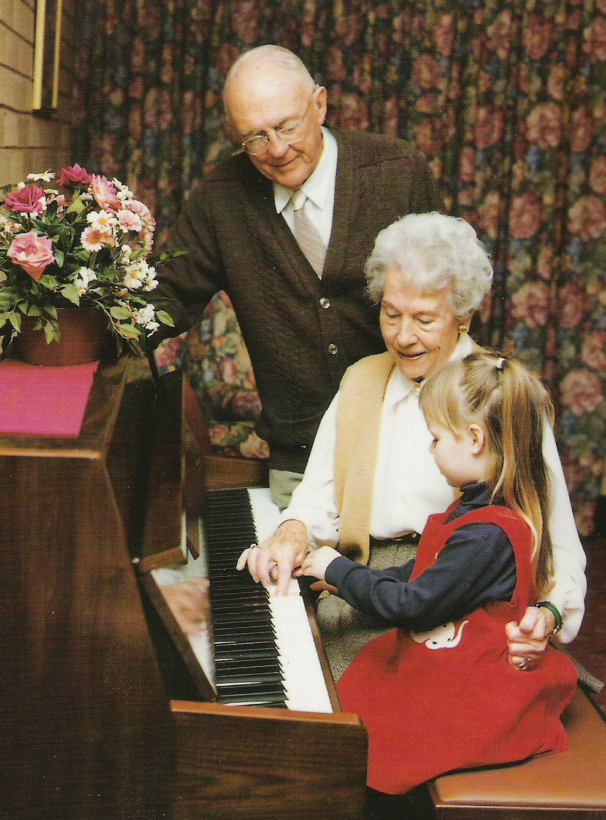

Slide 10
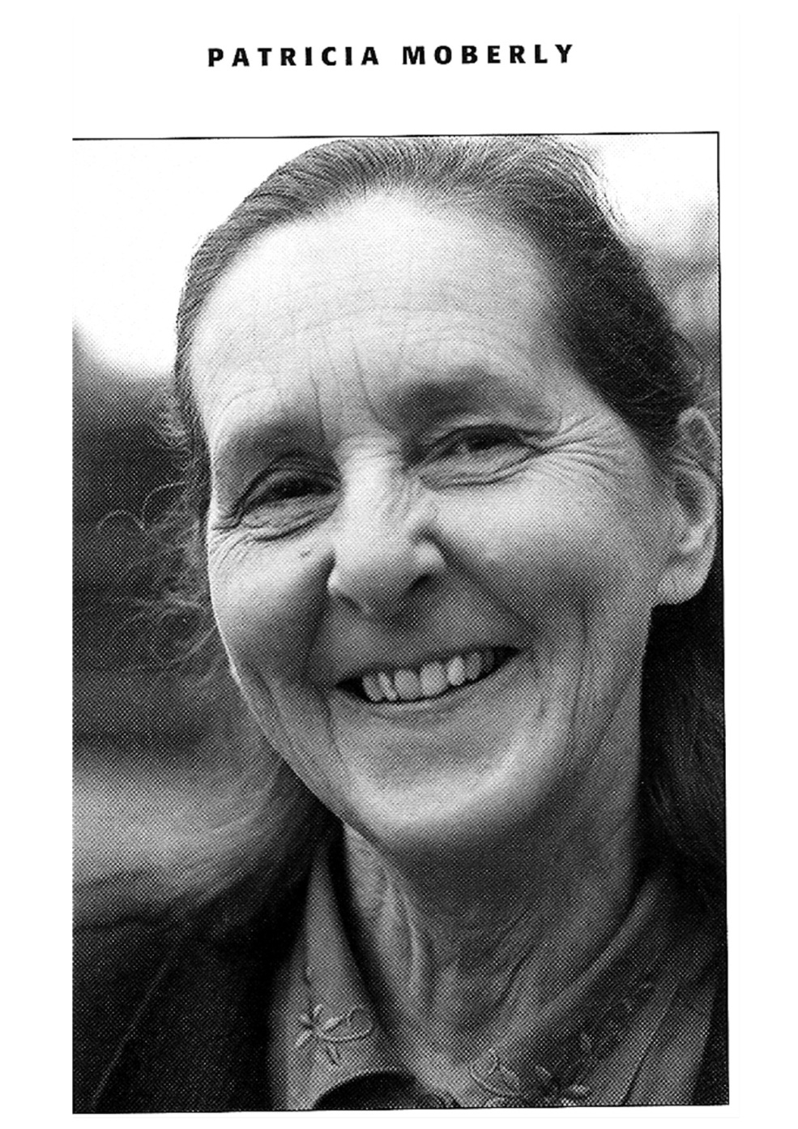

Slide 11
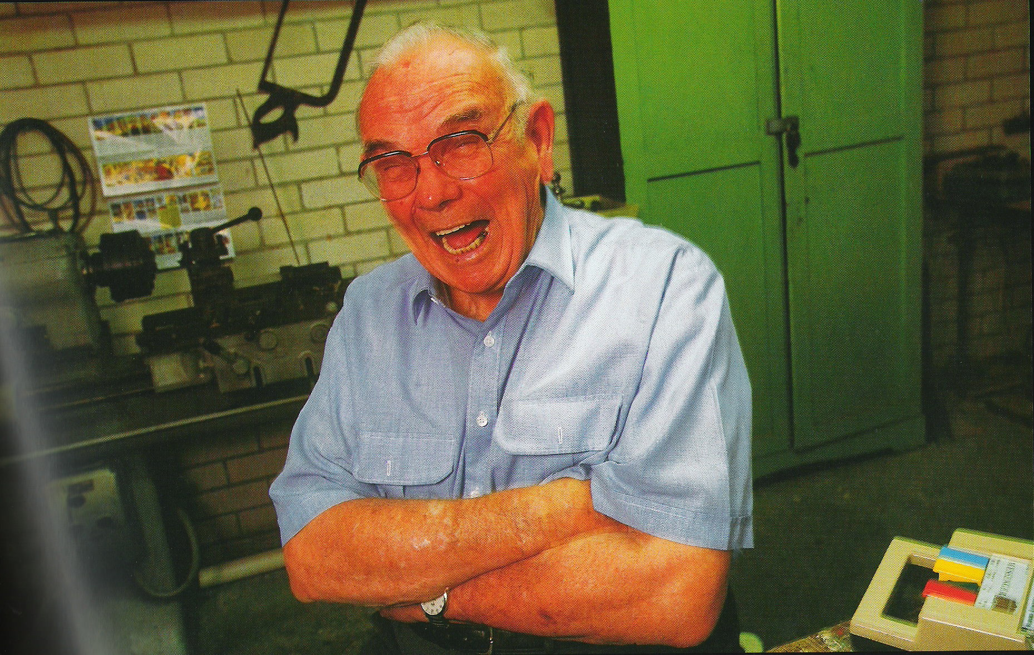

Slide 12
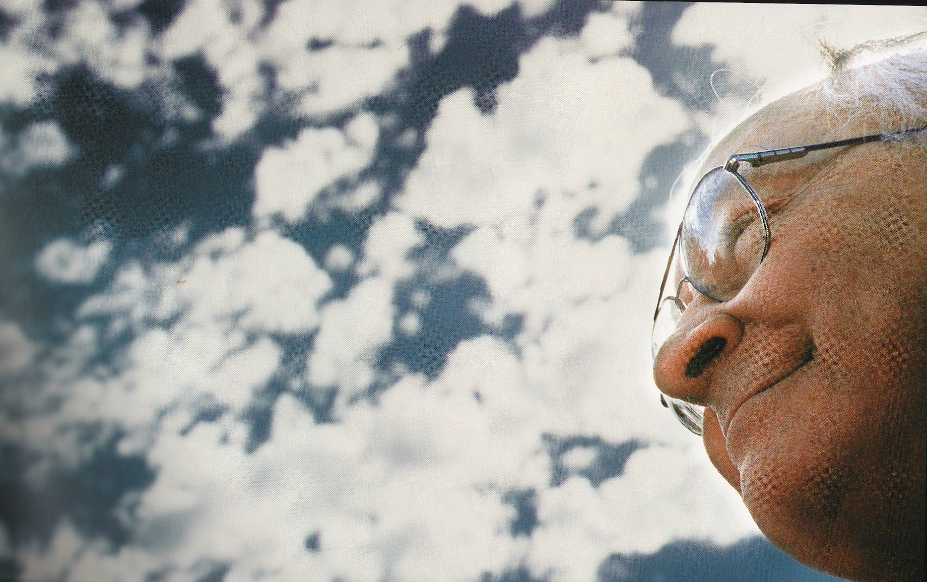

Slide 13
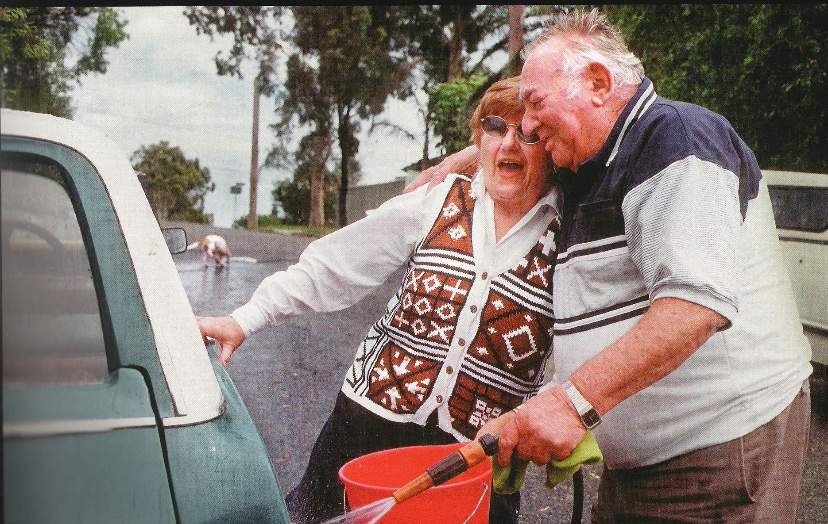

Slide 14
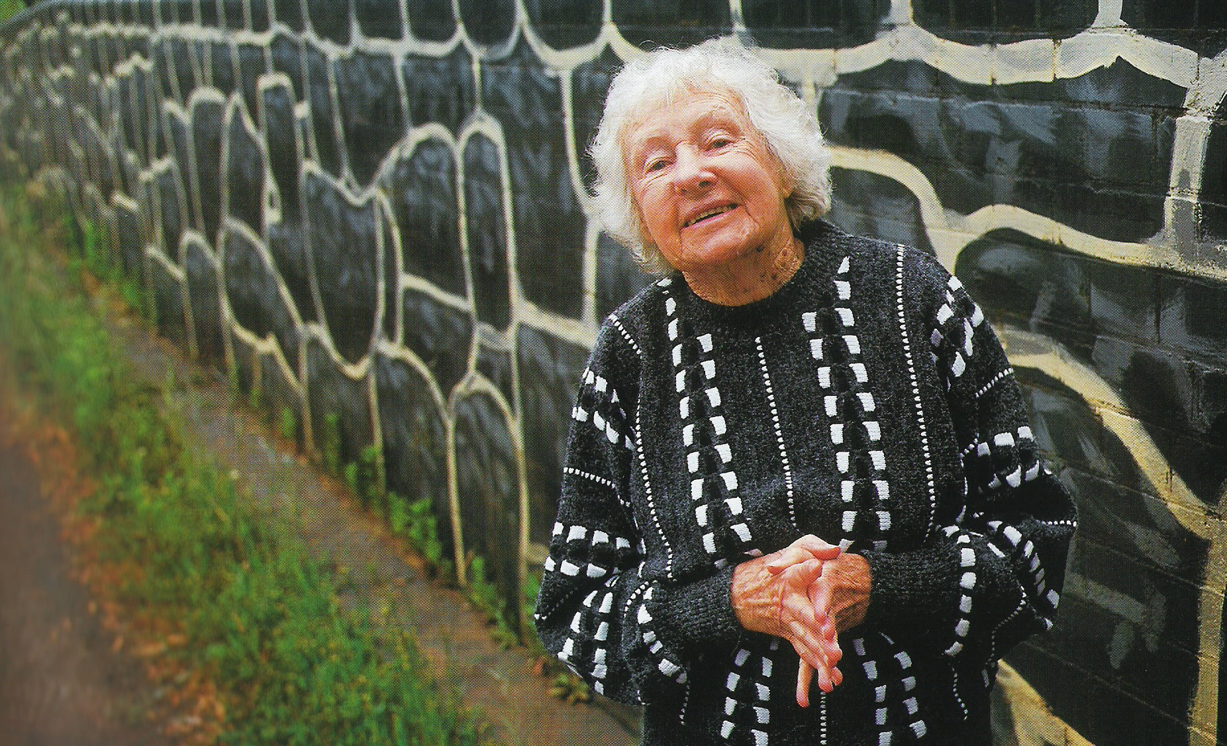

Slide 15
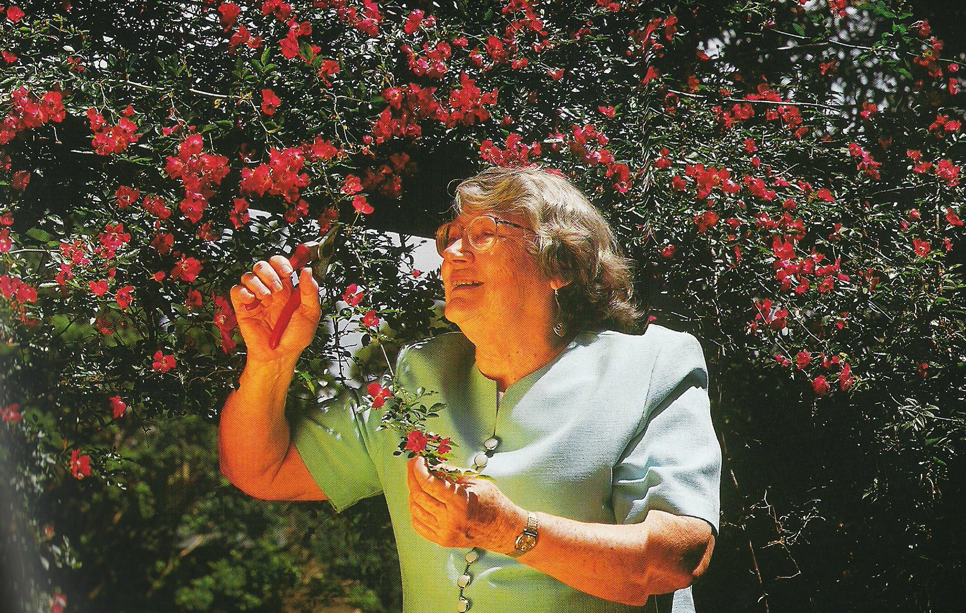

Slide 16
Liturgy for Grandparents
Gratitude for Grandparents
Use of the Bible
Use of dialogue and experience
Teaching and nurture in the Faith
Interaction across the ages
Appropriate to Context

Slide 17
Other Resources
Church Services for People with Dementia
Worship and people with Dementia (MHA)
Older People, Faith and Dementia (24 Practical Talks for use in Care Homes)
Lighting the Way – Spiritual and Religious Care for those with Dementia
Spiritual care for older people is a series of factsheets from the Diocese of Oxford: http://eauk.co/2mF2Knn

Slide 18
Where are your gaps and needs?

